Slide 1
10 Great Business Databases to Mine for Stories
Steve Doig
Cronkite School, ASU
Steve.doig@asu.edu

Slide 2
>10 Great Databases to Mine for Business Stories
Steve Doig
Cronkite School, ASU
Steve.doig@asu.edu

Slide 4
www.census.gov

Slide 5
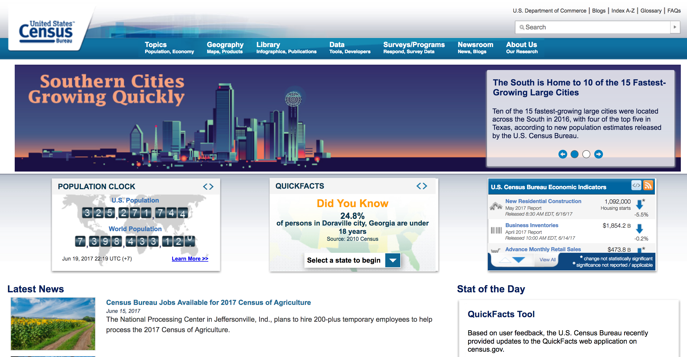
Notes:
Census is the motherlode

Slide 6
Decennial and ACS business/economics variables
Employment status
Occupation
Industry
Class of worker
Income
Health insurance coverage
Commuting
Place of Work

Slide 7
Census Business Help Site
bhs.econ.census.gov

Slide 8
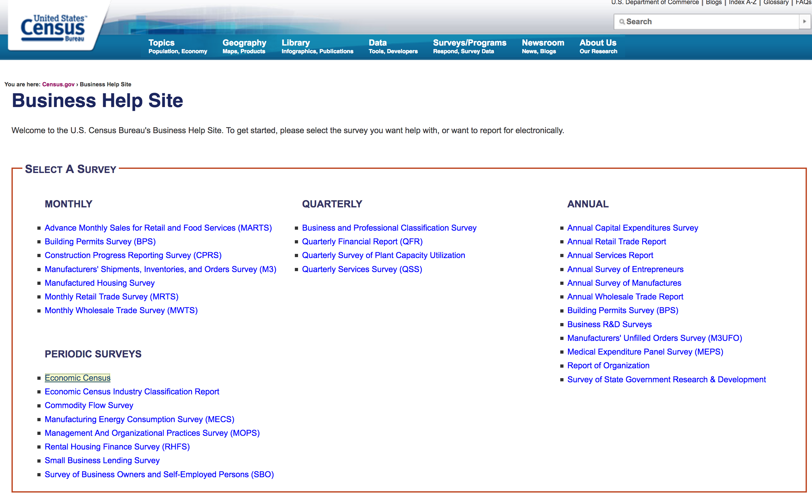
bhs.econ.census.gov

Slide 9
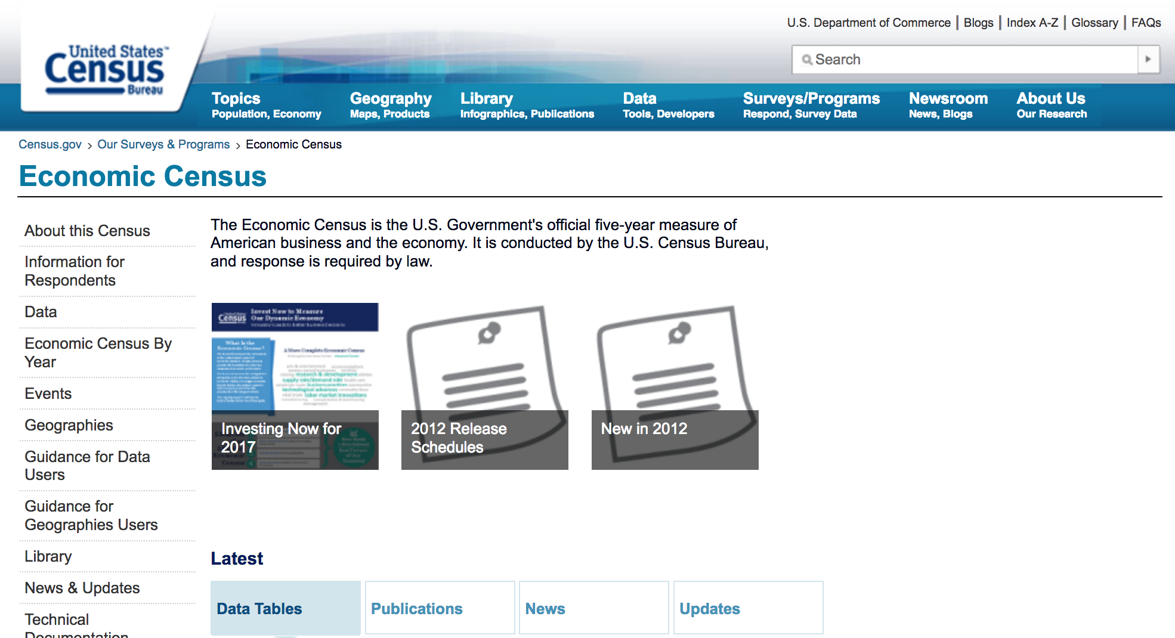
www.census.gov/programs-surveys/economic-census.html
Notes:
Done every five years...most recent 2012...went to 4 million large, medium and small businesses
Just one of dozens of surveys and reports

Slide 10
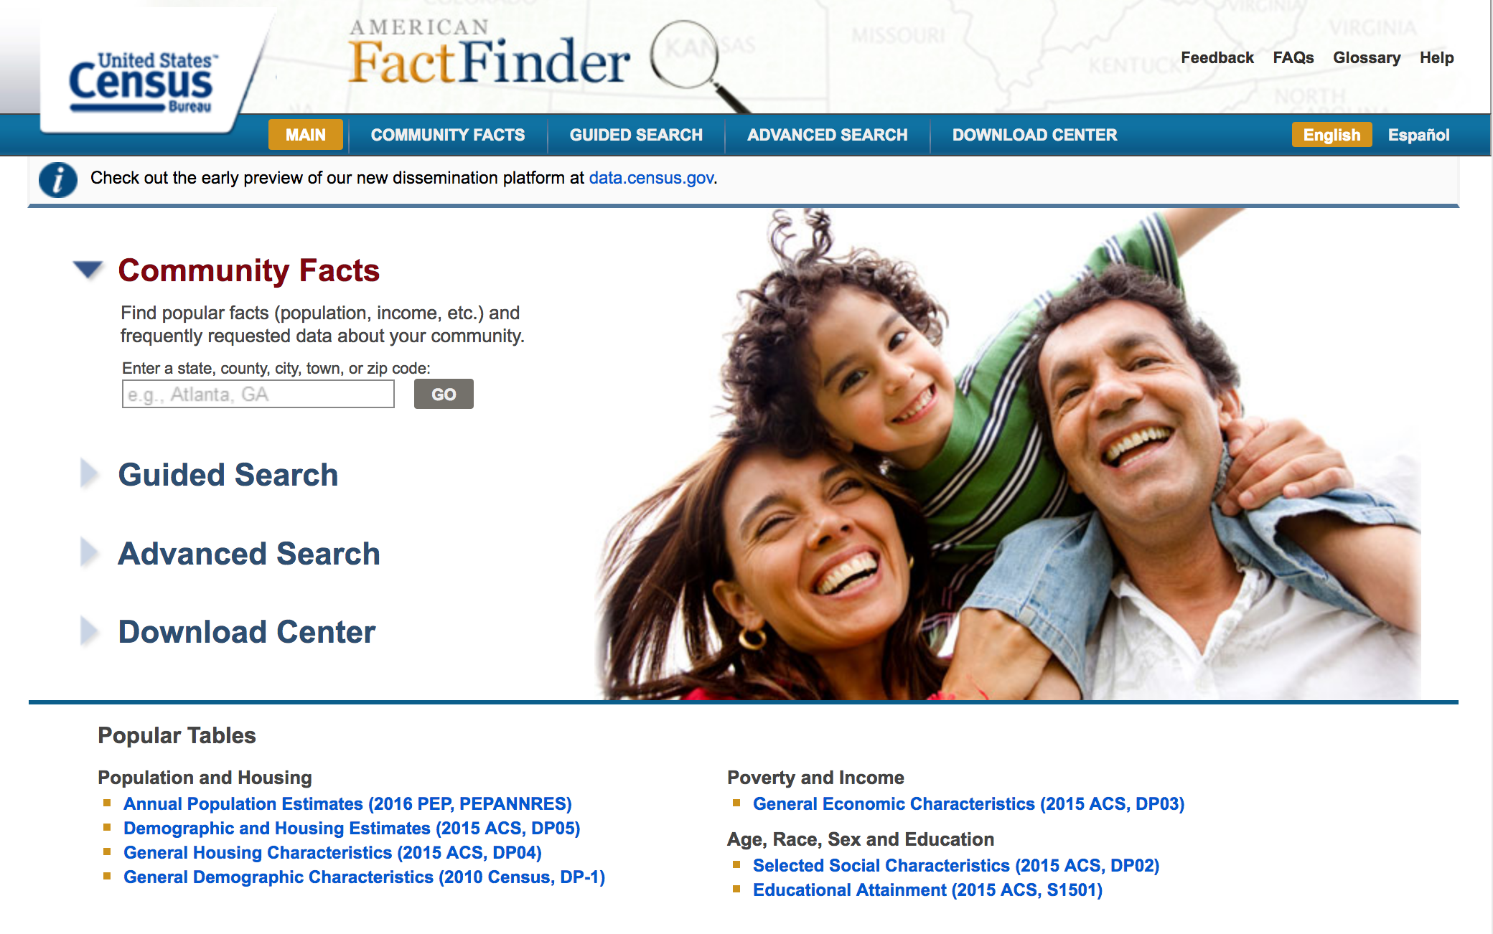
Factfinder.census.gov
Notes:
AFF is the portal for getting premade tables and for downloading data

Slide 11
Economic categories in FactFinder
Assets & Capital Expenditures
Business Characteristic
Business Owners
Economic Series
Employment
Establishments/Firms
Expenses & Purchased Services
Fuels & Materials
Inventories
Labor Costs
Sales, Receipts, Revenue, or Shipments

Slide 12
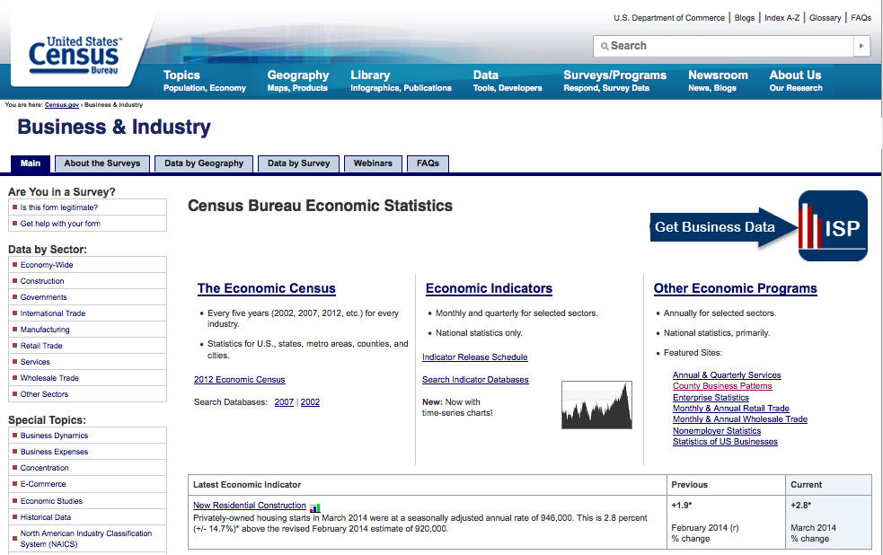

Slide 13
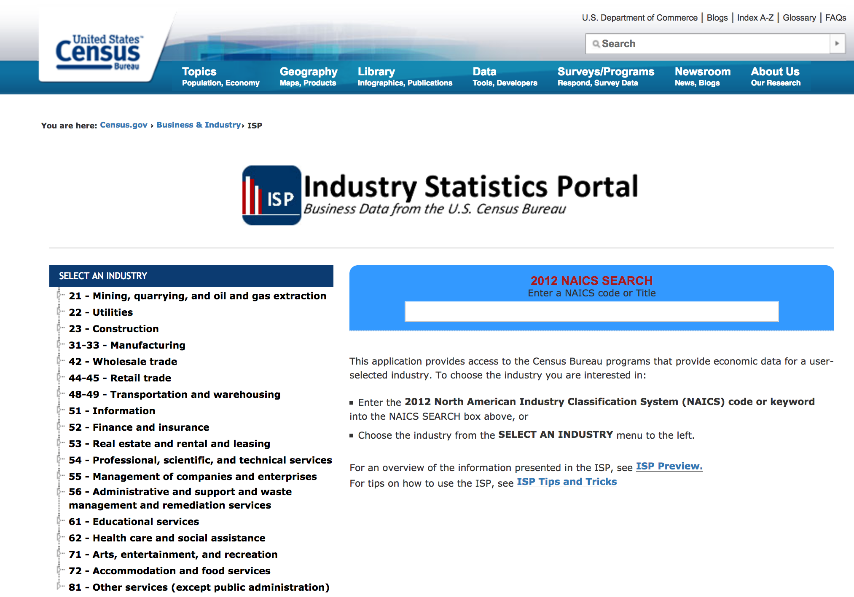
www.census.gov/econ/isp/

Slide 14
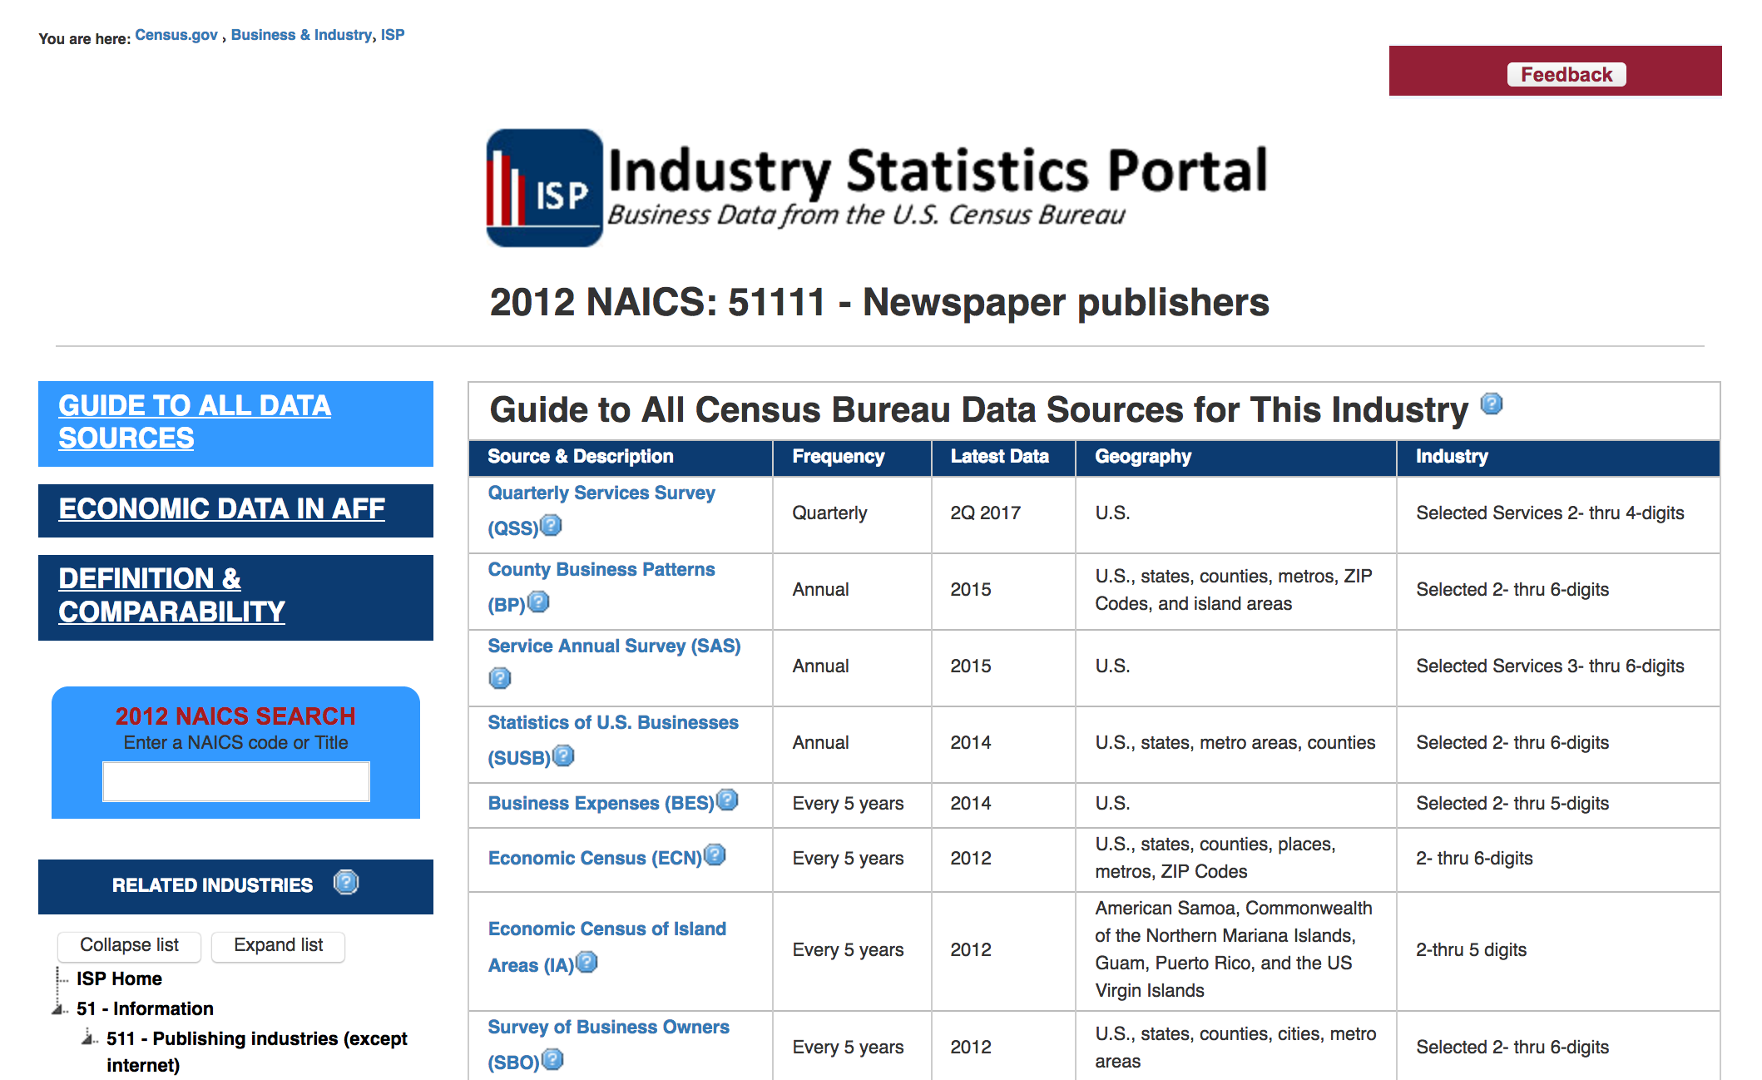

Slide 15
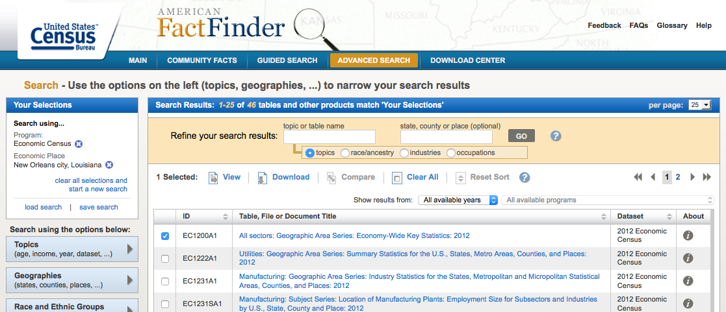
Economy-wide Key Statistics

Slide 16
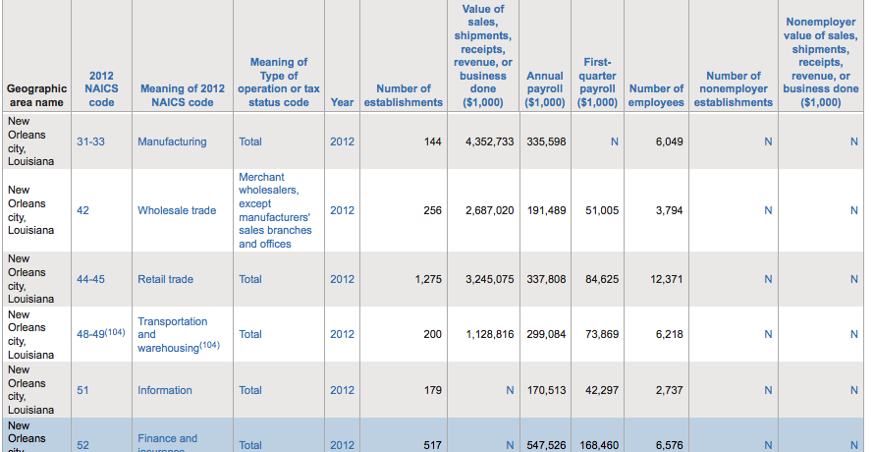
Notes:
Can pull out summary tables by geographies of interest for 2012 and 2007…measure impact of recession.

Slide 17
Other Census economic reports

Slide 18
Monthly reports
Advance Monthly Sales for Retail and Food Services
Building Permits
Construction Spending
Construction Progress Reporting Surveys
Current Industrial Reports
Export Statistics
Import Statistics
Manufactured Homes Survey
Manufacturers' Shipments, Inventories, and Orders
Manufacturing and Trade Inventory and Sales
Monthly Retail Trade and Food Services Survey
Monthly Wholesale Trade
New Residential Construction
New Residential Sales
Survey of Construction

Slide 19
Quarterly reports
Current Industrial Reports
Federal Assistance Awards Data System
Plant Capacity Utilization
Quarterly Financial Report
Quarterly Public-Employee Retirement System Survey
Quarterly Services Survey
Quarterly Workforce Indicators
Retail E-Commerce Sales

Slide 20
Annual reports
Annual Capital Expenditures Survey
Annual Public Employment Survey
Annual Retail Trade Survey
Annual Survey of Manufactures
Annual Survey of State and Local Government Finances
Business Dynamics Statistics
Business R & D and Innovation Survey
Consolidated Federal Fund Report
County Business Patterns
Current Industrial Reports
E-Stats (E-Commerce Statistics)
Enterprise Statistics
Exports from Manufacturing Establishments
Federal Audit Clearinghouse
Information and Communication Technology Survey
Local Government School System Finance Survey
Medical Expenditure Panel Survey
Non-employer Statistics
Profile of U.S. Exporting Companies
Service Annual Survey
State Government Tax Collections Survey
State and Local Government Public-Employee Retirement Systems
Statistics of U.S. Businesses
Tax Collections
Notes:
County Business Patterns very userful
he number of establishments, employment during the week of March 12, first quarter payroll, and annual payroll.

Slide 21
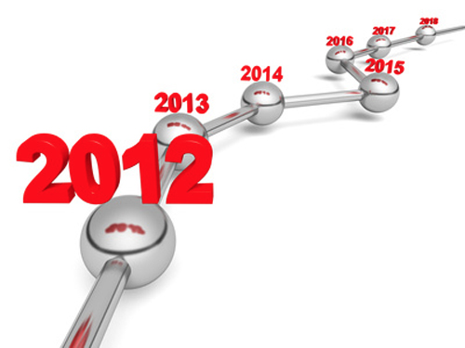
Every five years
Business Expenses
Commodity Flow Survey
Economic Census
Economic Census of Island Areas
Governments Integrated Directory
Survey of Business Owners

Slide 22
Foreign trade

Slide 23
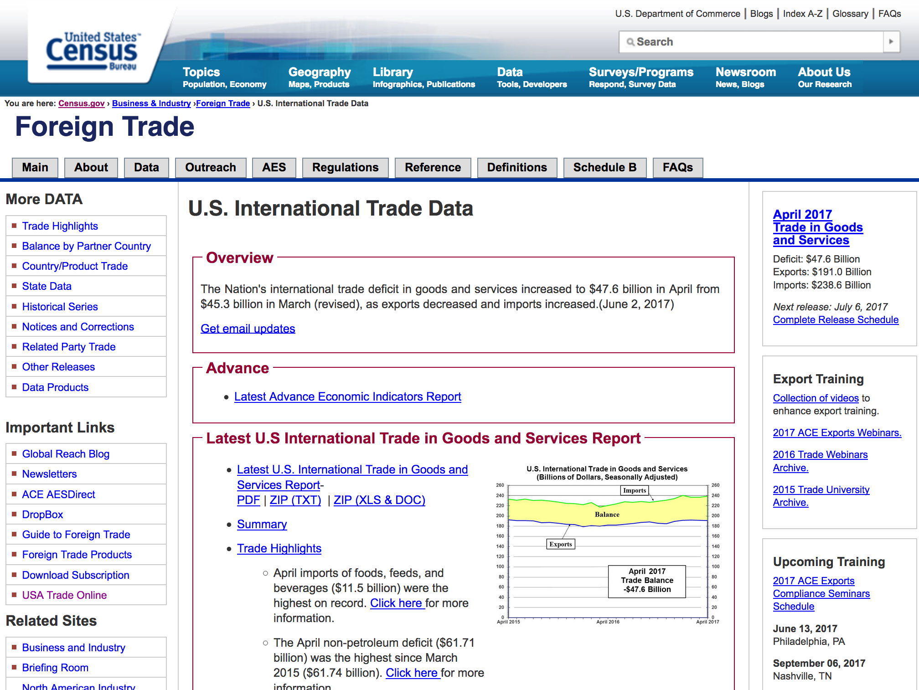
www.census.gov/foreign-trade/data/index.html

Slide 24
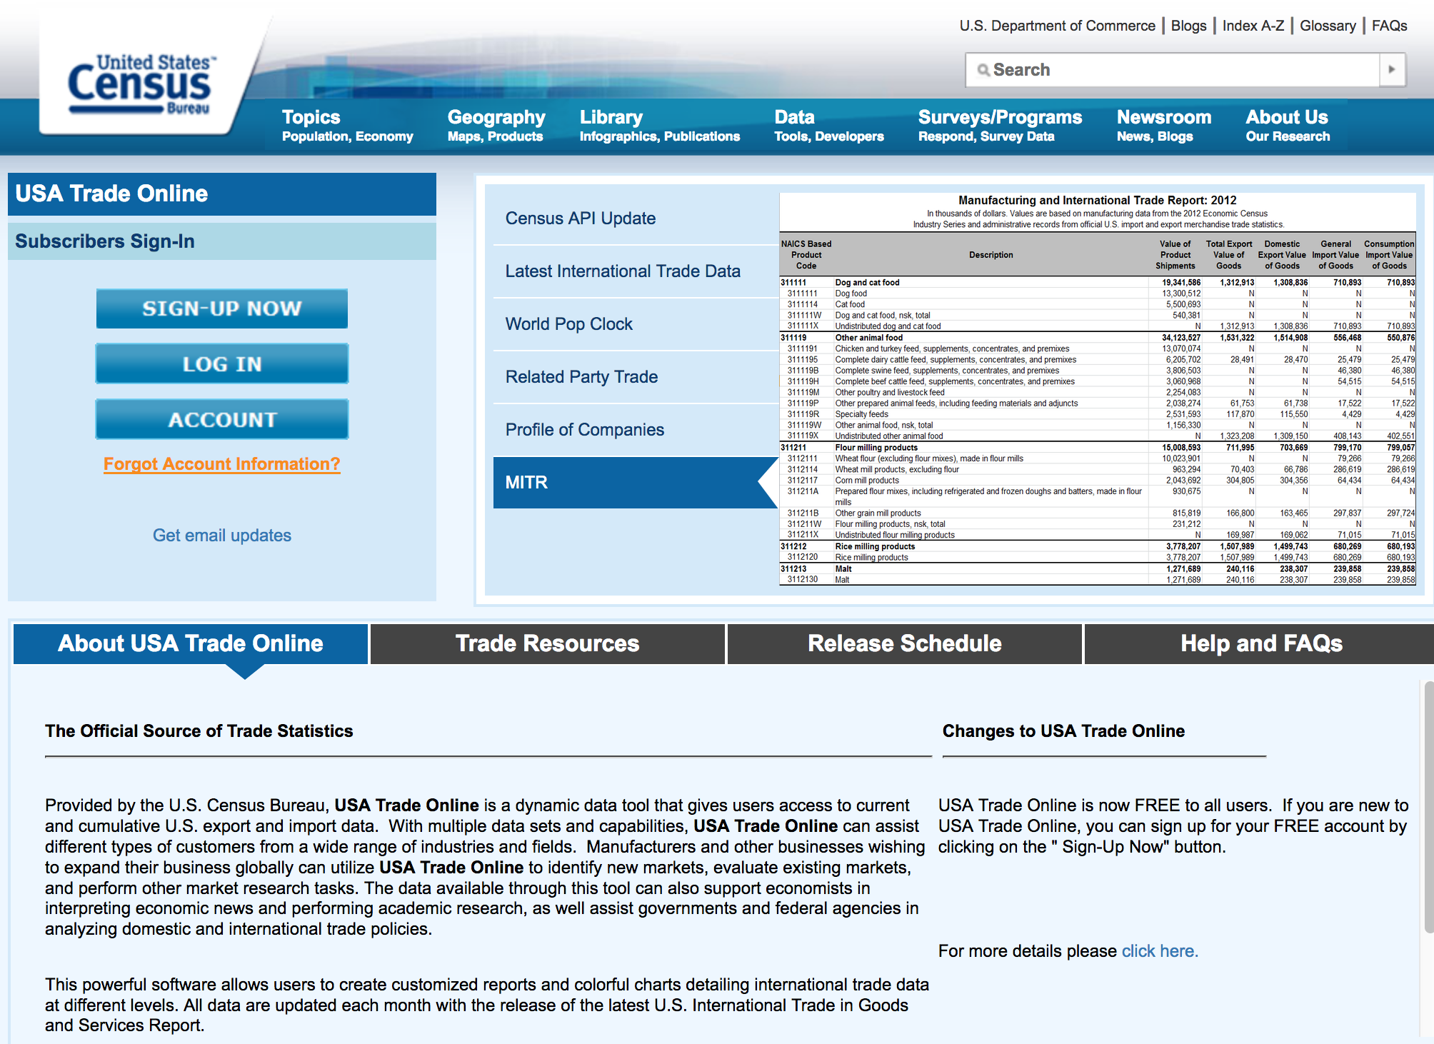
U.S. Trade Online (usatrade.census.gov)
Notes:
Now free!!!
FactFinder-like interface
Can pull up data by country, port of entry, type of product, month/year

Slide 25
www.census.gov/programs-surveys/cbp.html
Notes:
number of establishments, employment during the week of March 12, first quarter payroll, and annual payroll.
State, county, ZIP

Slide 26
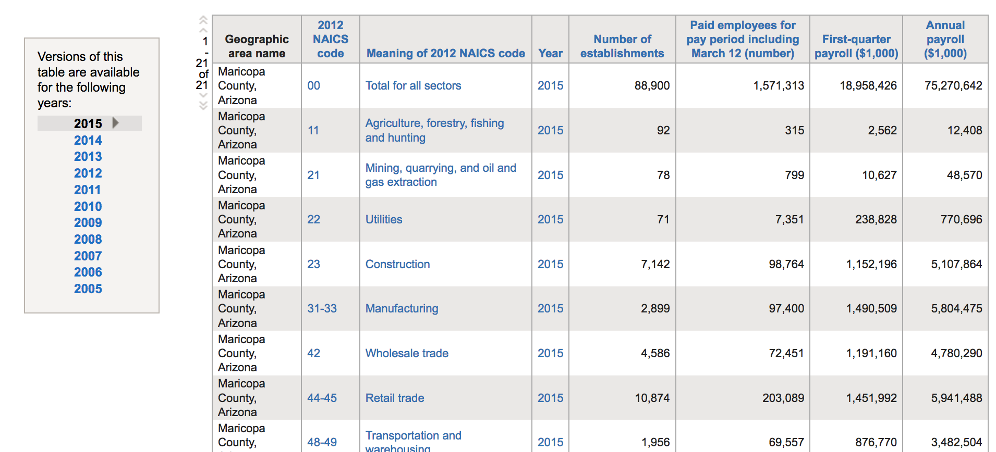
Table from factfinder.census.gov

Slide 27
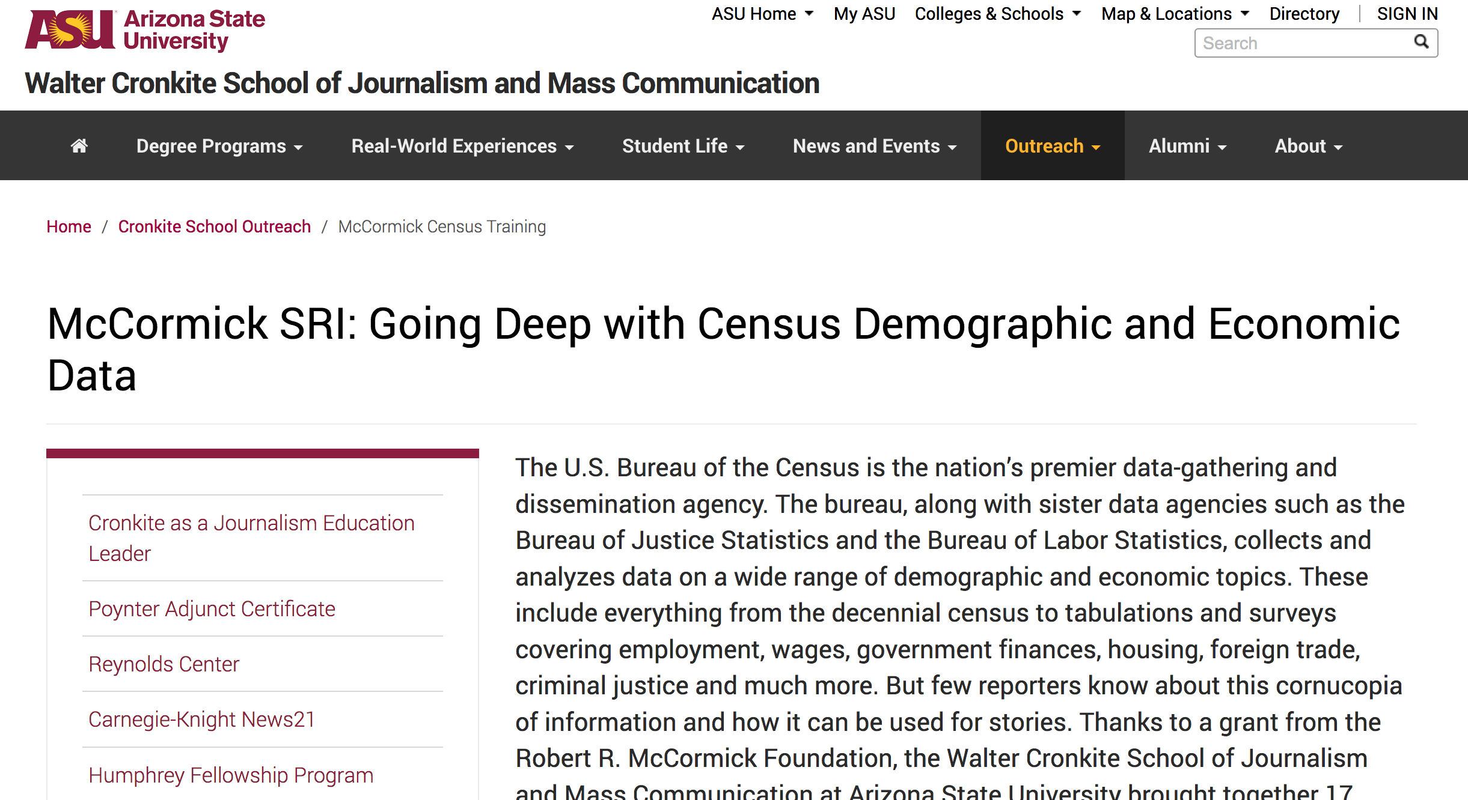
cronkite.asu.edu/outreach/mccormick-census-training

Slide 28
Bureau of Economic Analysis
Bea.gov

Slide 29
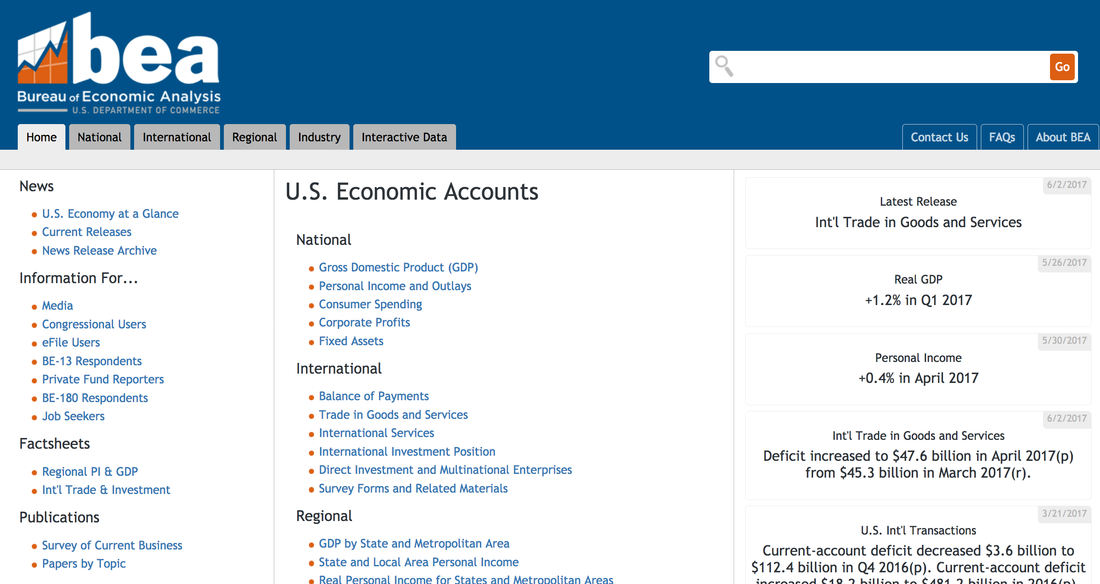
Notes:
BEA does many economic studies, including GDP by month
Also econ activity by region, state, metro0, county

Slide 30
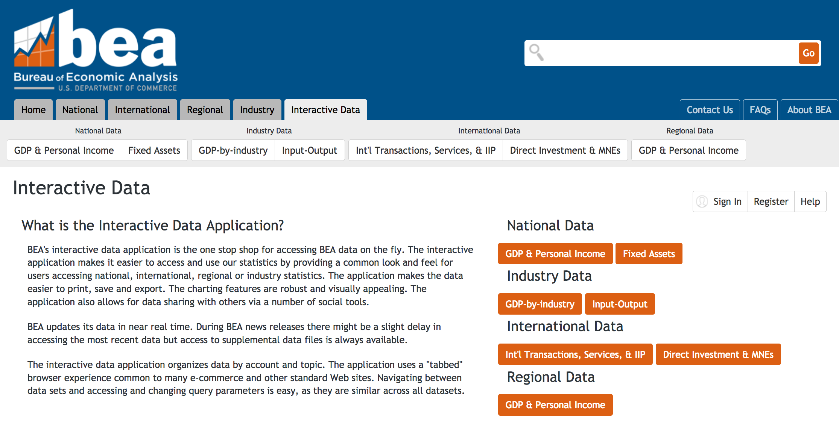

Slide 31
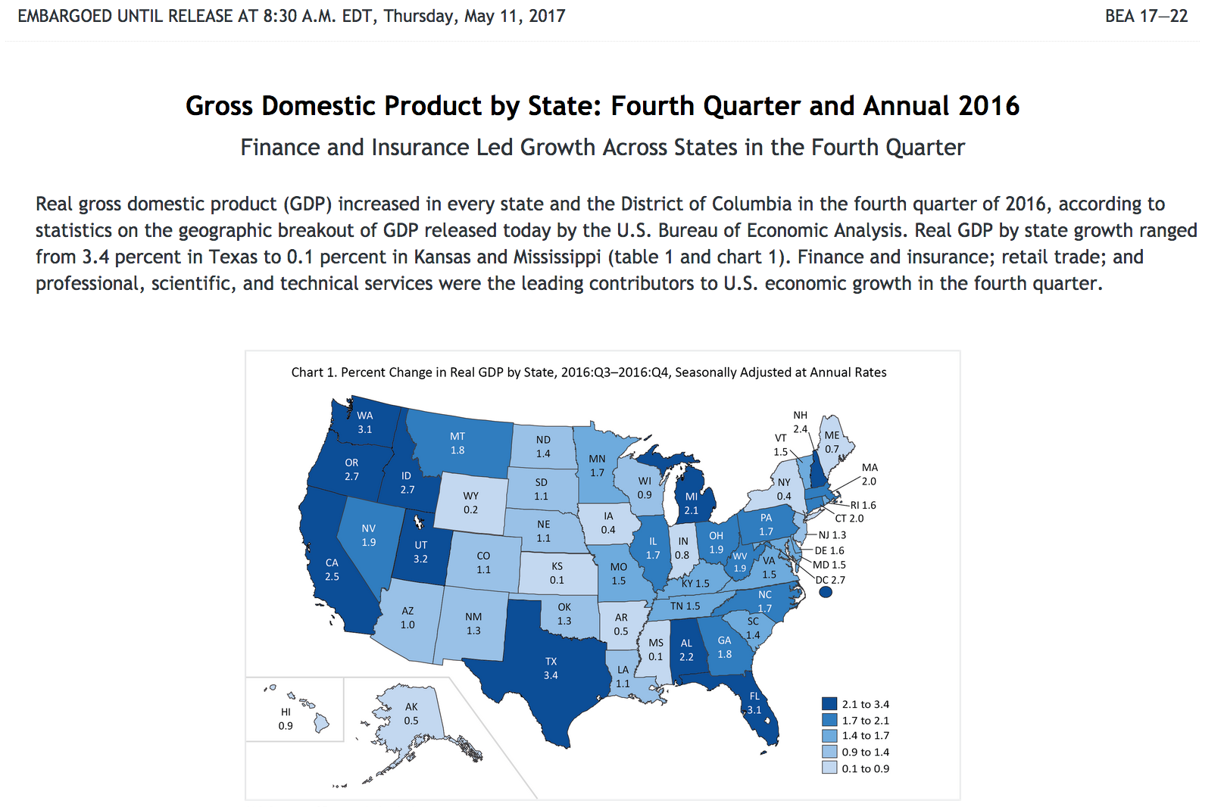
GDP by state

Slide 32
Federal Reserve
Federalreserve.gov

Slide 33
Notes:
US central banking system
-- conduct monetary policy
-- keeps financial system stable
-- promotes safety of financial institutions
-- promotes consumer protection

Slide 34
Notes:
Example under the data tab

Slide 35
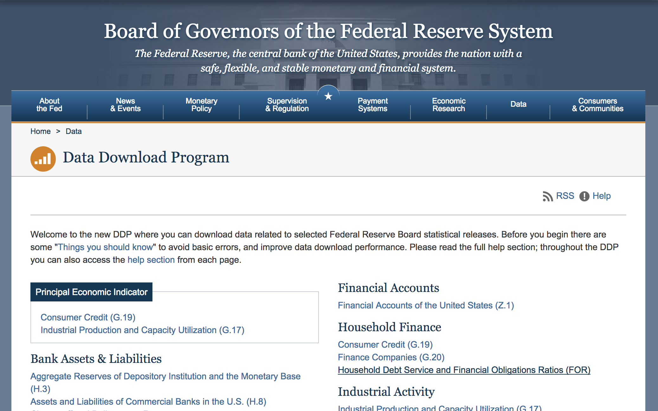
www.federalreserve.gov/datadownload/

Slide 36
Securities and Exchange Commission
Sec.gov

Slide 38
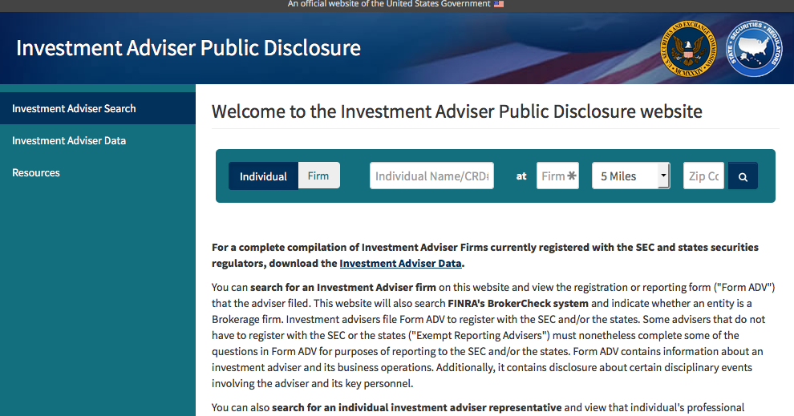
adviserinfo.sec.gov/

Slide 39
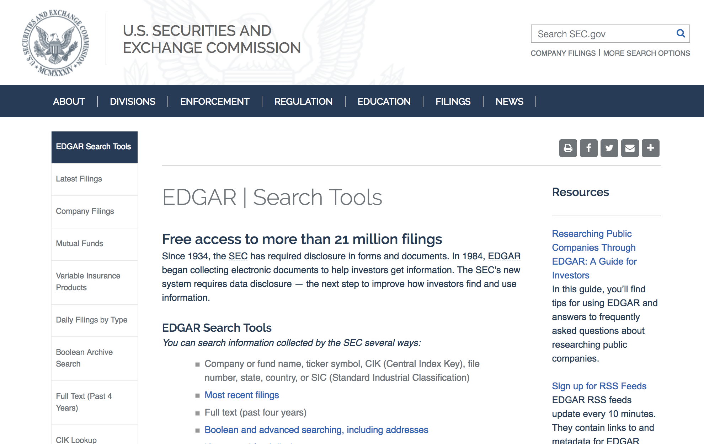
www.sec.gov/edgar/searchedgar/webusers.htm
Notes:
EDGAR for stock filings

Slide 40
Sqoop.com
Notes:
One stop shopping for company information
Special for SEC flings, patent searches and PACER federal courts

Slide 41
Pacer: Federal Courts filings
PACER.gov
Notes:
Federal court filings, bankruptcies

Slide 42
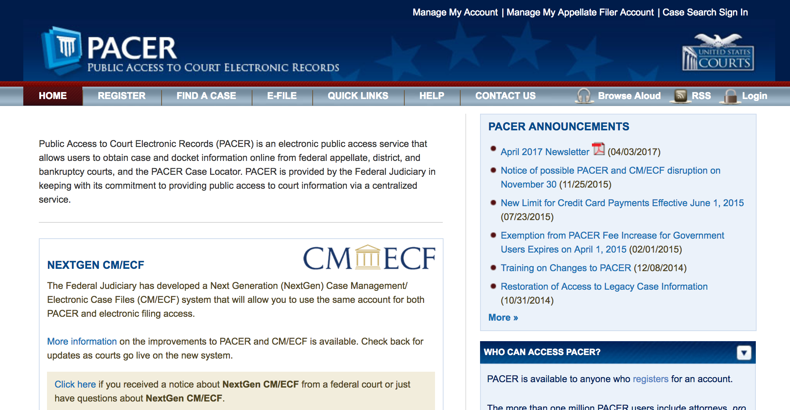
Pacer.gov

Slide 43
Bureau of Labor Statistics
Bls.gov

Slide 44
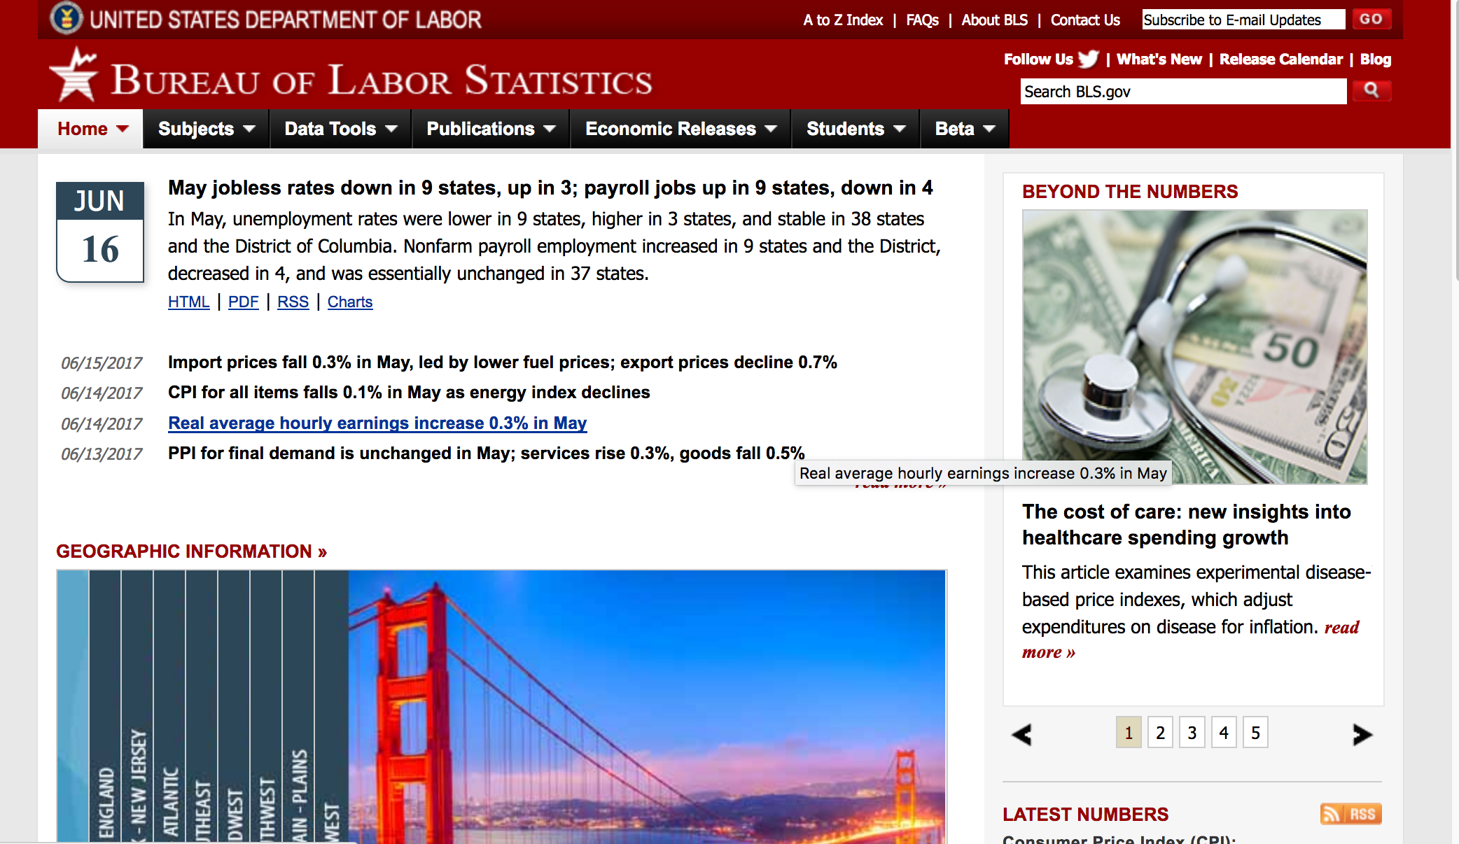

Slide 45
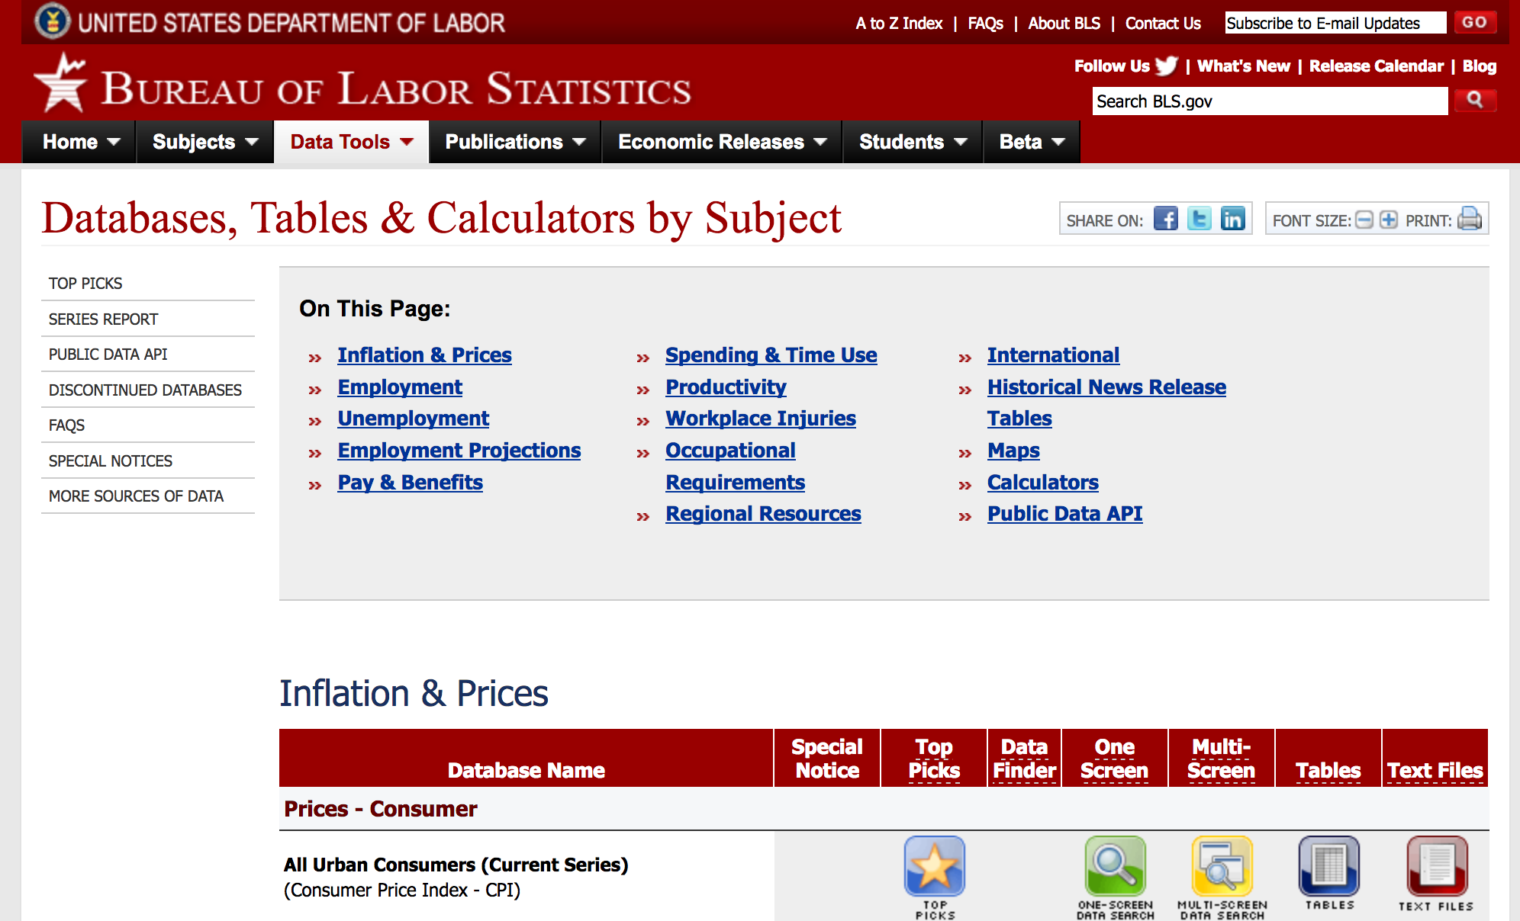
www.bls.gov/data/

Slide 46
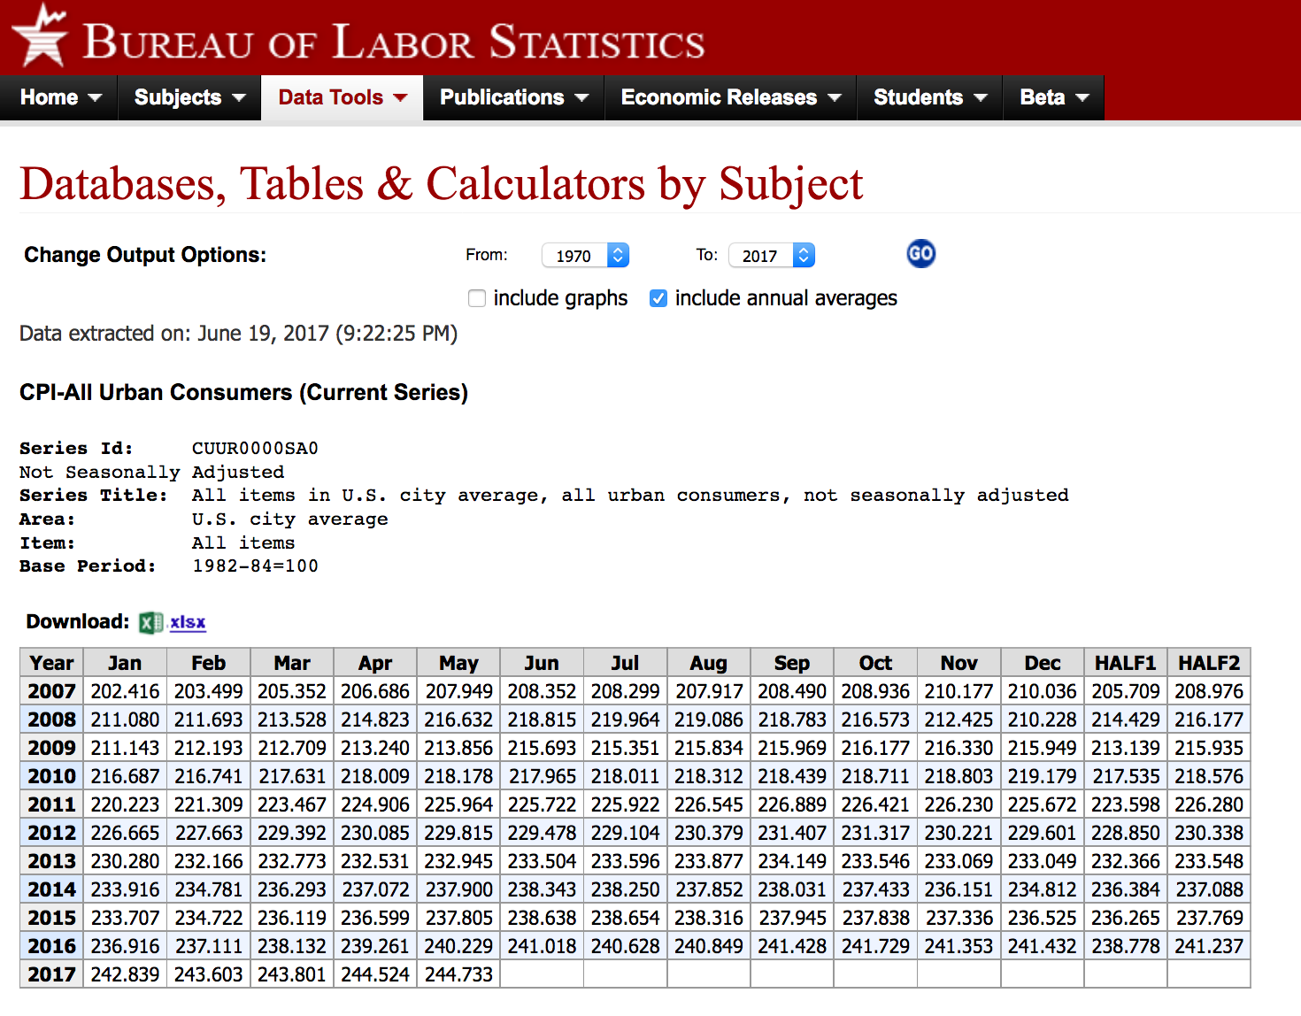
Consumer Price Index tables
Notes:
CPI back to 1913

Slide 47
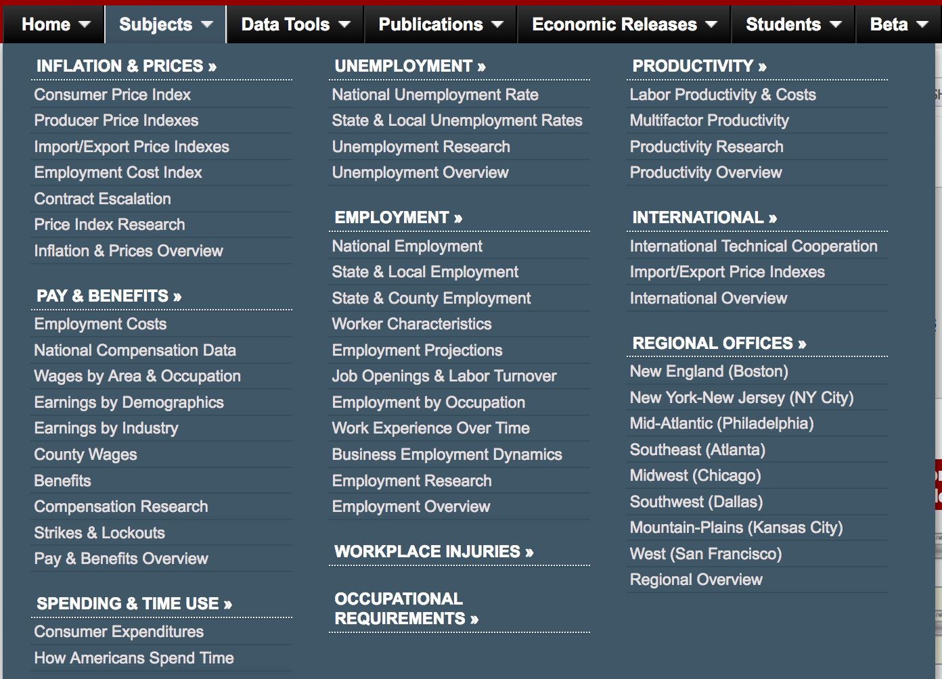

Slide 48
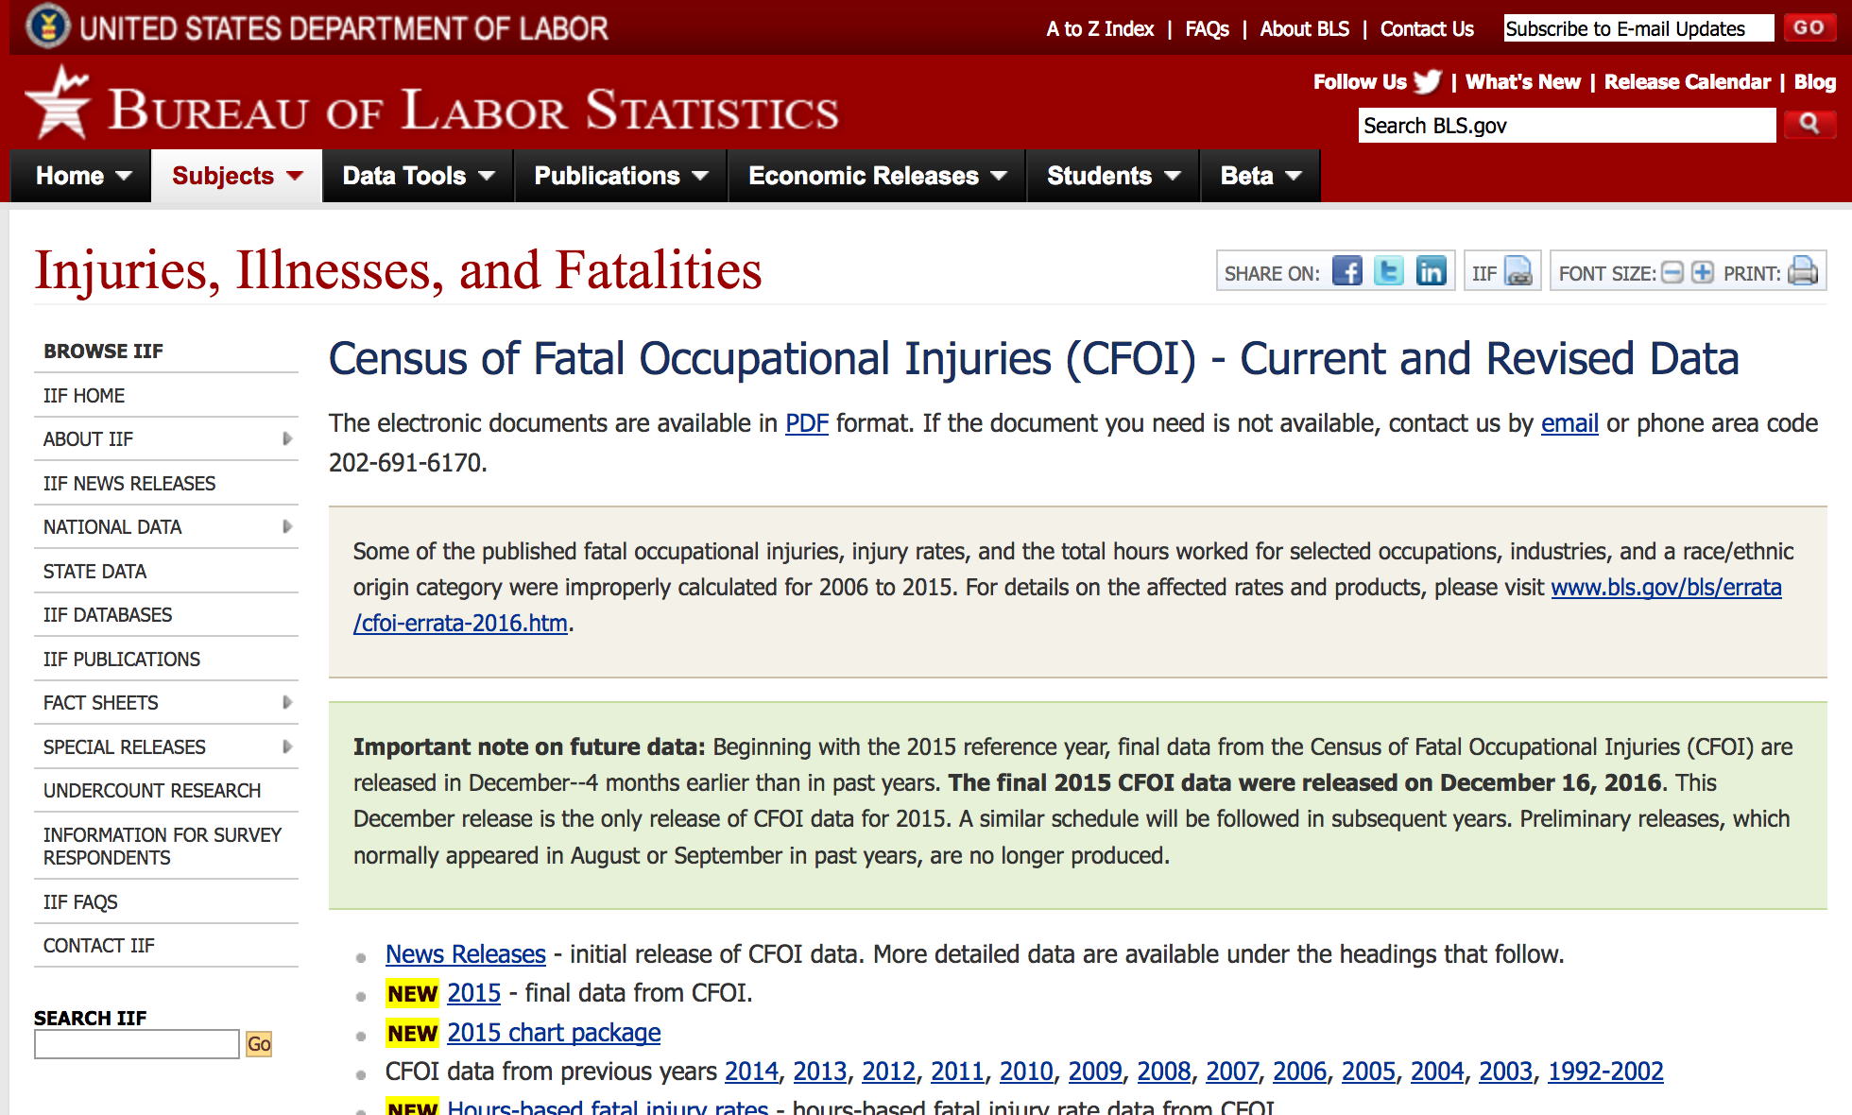

Slide 49
State and local business data

Slide 50
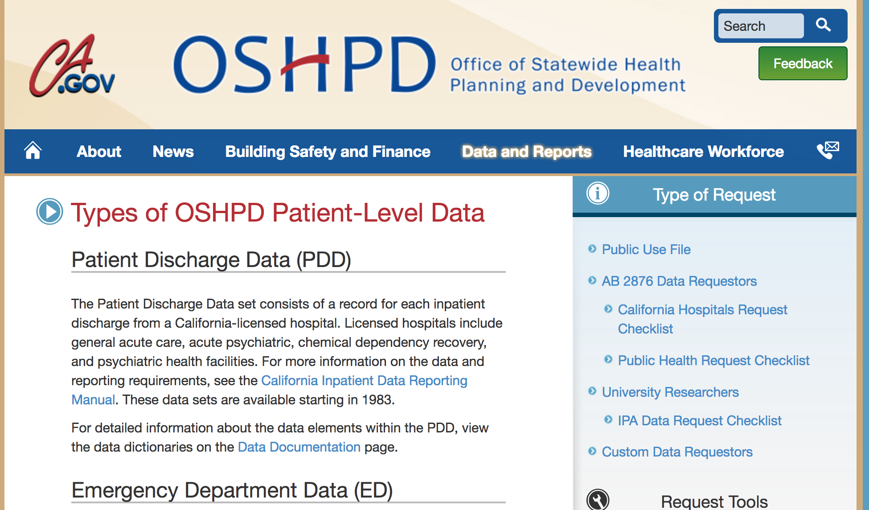
Notes:
Hospital discharge data

Slide 51
Hospital patient discharge data
Each state health department has a database of this
Discharge from emergency department or hospital in-patient
Each record is a patient
Millions of records (use SQL or other)
Charges for the data?
Variables:
Age/race/gender, ZIPcode
Name of hospital, doctor, surgeon
Up to 24 Diagnoses (ICD-9 or -10 codes)
Up to 20 treatment codes, including date
Charges for each hospital service
Discharge status (sent home, admit to hospital, law ewnforcement, died, et al.)
Who pays (insurance, Medicare, self, etc.)

Slide 52
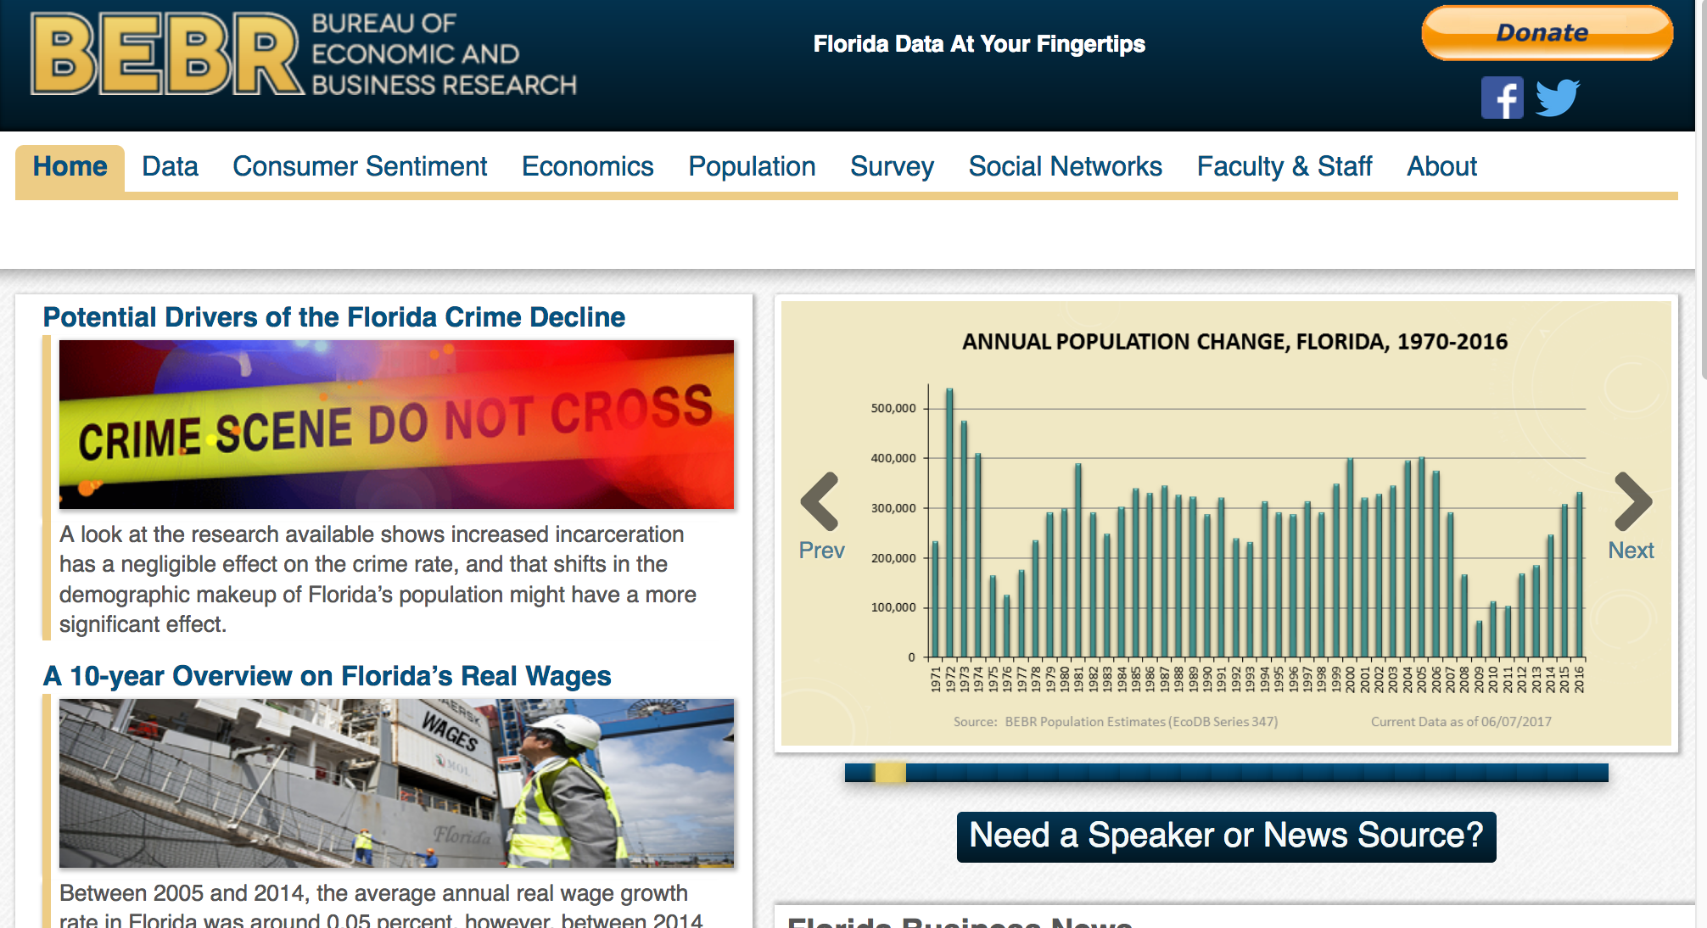
Notes:
Most states have some sort of business/economic research unit
Often located at major university

Slide 53
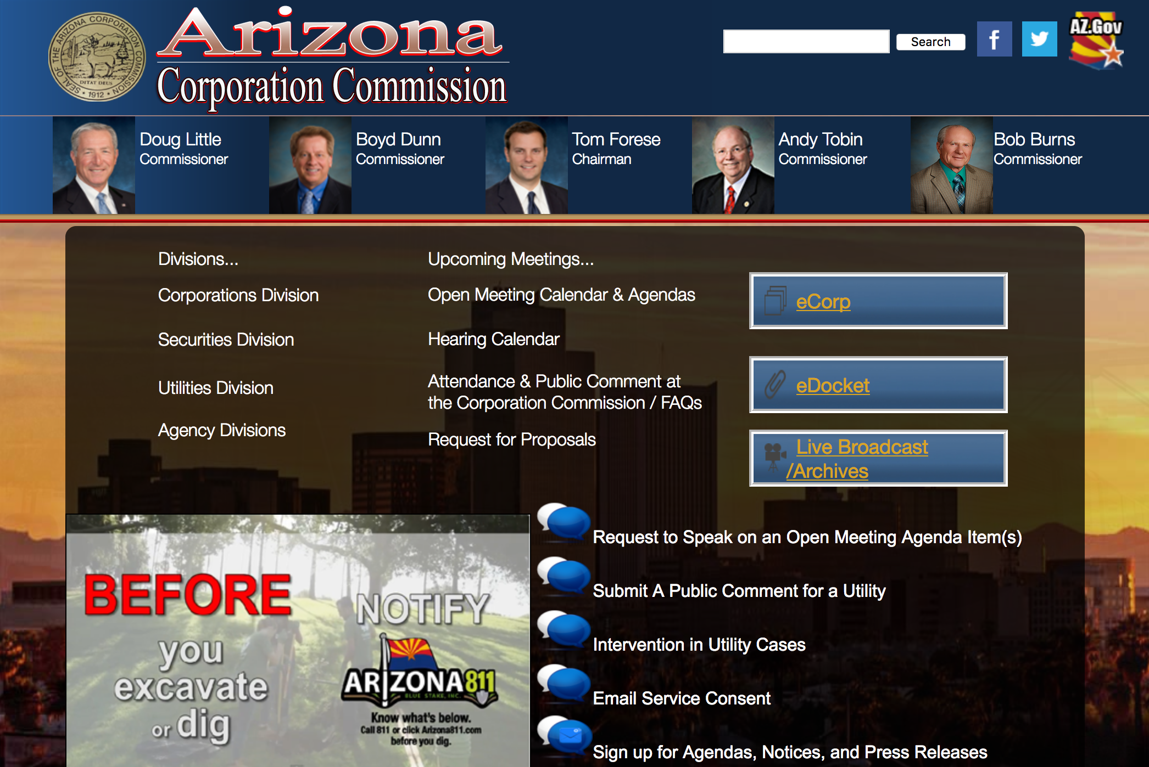
Notes:
Corporate filings, securities regulation

Slide 54
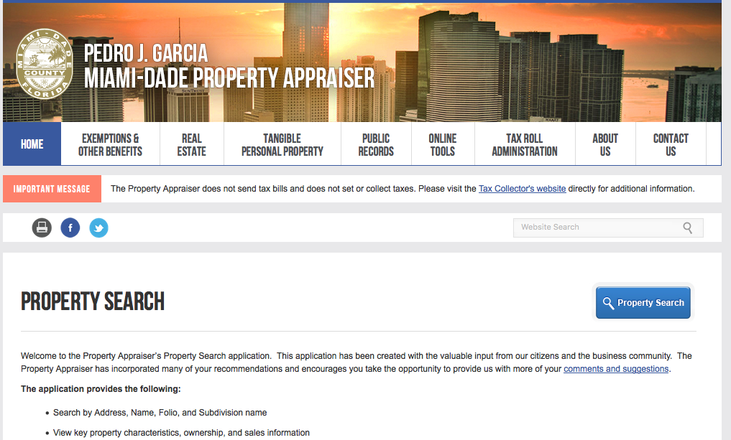
Notes:
Property tax roll
Valuation history, sale history, details about property, exemptions

Slide 55
Professional licenses
Medical boards (doctors, nurses, dentists, etc.)
Attorneys
Contractors
Accountants
Cosmetologists
Funeral directors
Opticians/Optometrists
Pharmacists
Acupuncturists
Realtors
Veterinarians
Pest control
Driver training
Private investigators
Security guards
Polygraph examiners
Appraisers
Massage therapists
Notes:
More than 20% of workforce needs a license to operate

Slide 56
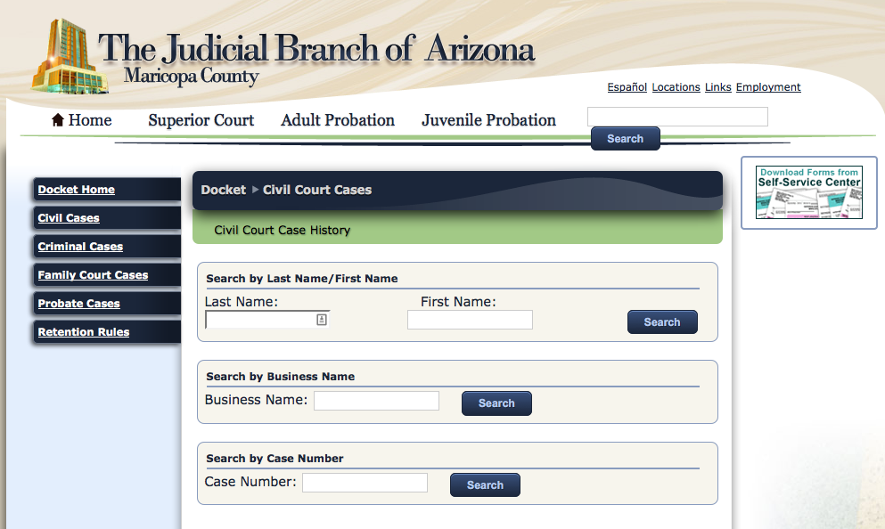
Notes:
Civil courts – who sues and gets sued

Slide 57
International data

Slide 58
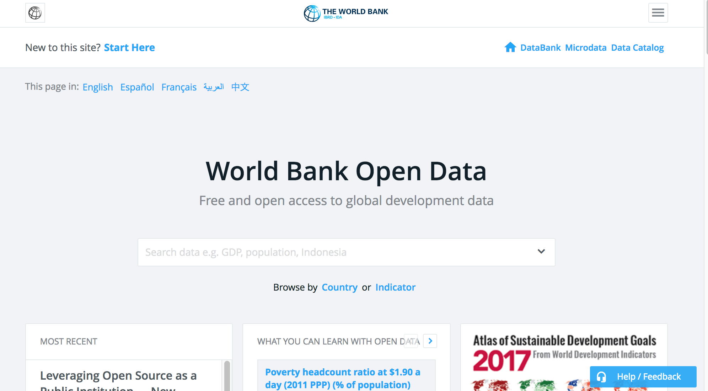
data.worldbank.org/

Slide 59
National statistics sites

Slide 60
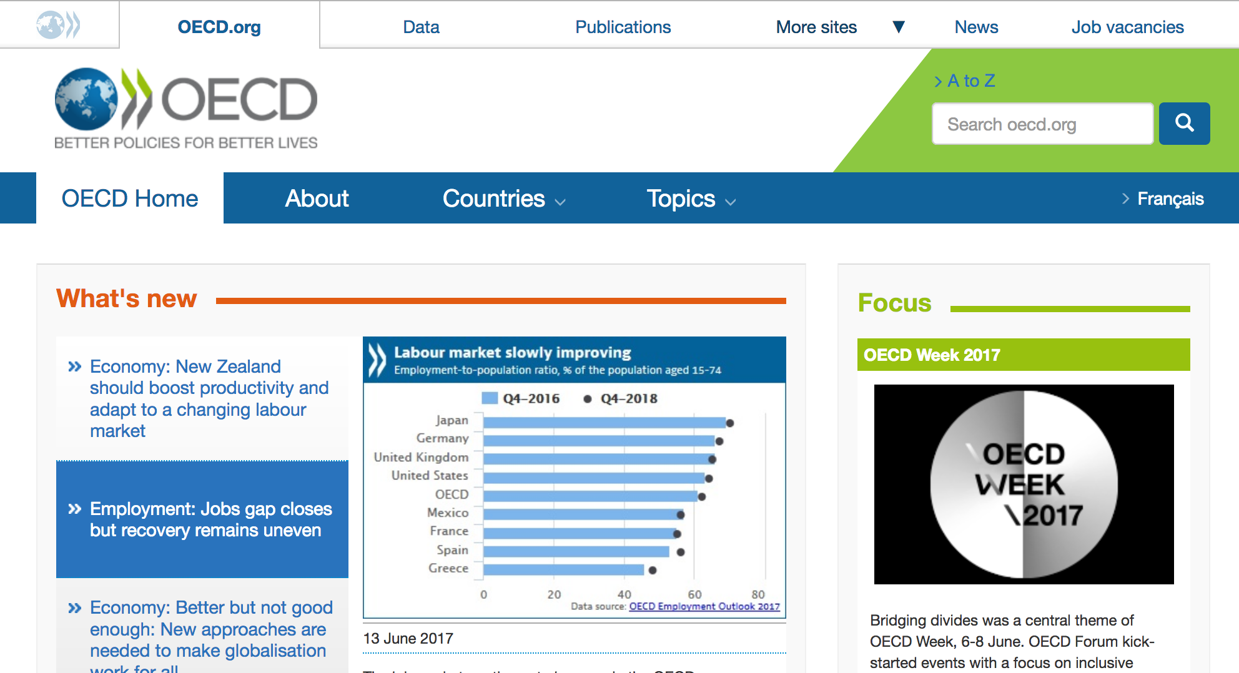
oecd.org
Notes:
Organization for Economic Co-operation and Development
OECD uses its wealth of information on a broad range of topics to help governments foster prosperity and fight poverty through economic growth and financial stability.

Slide 61
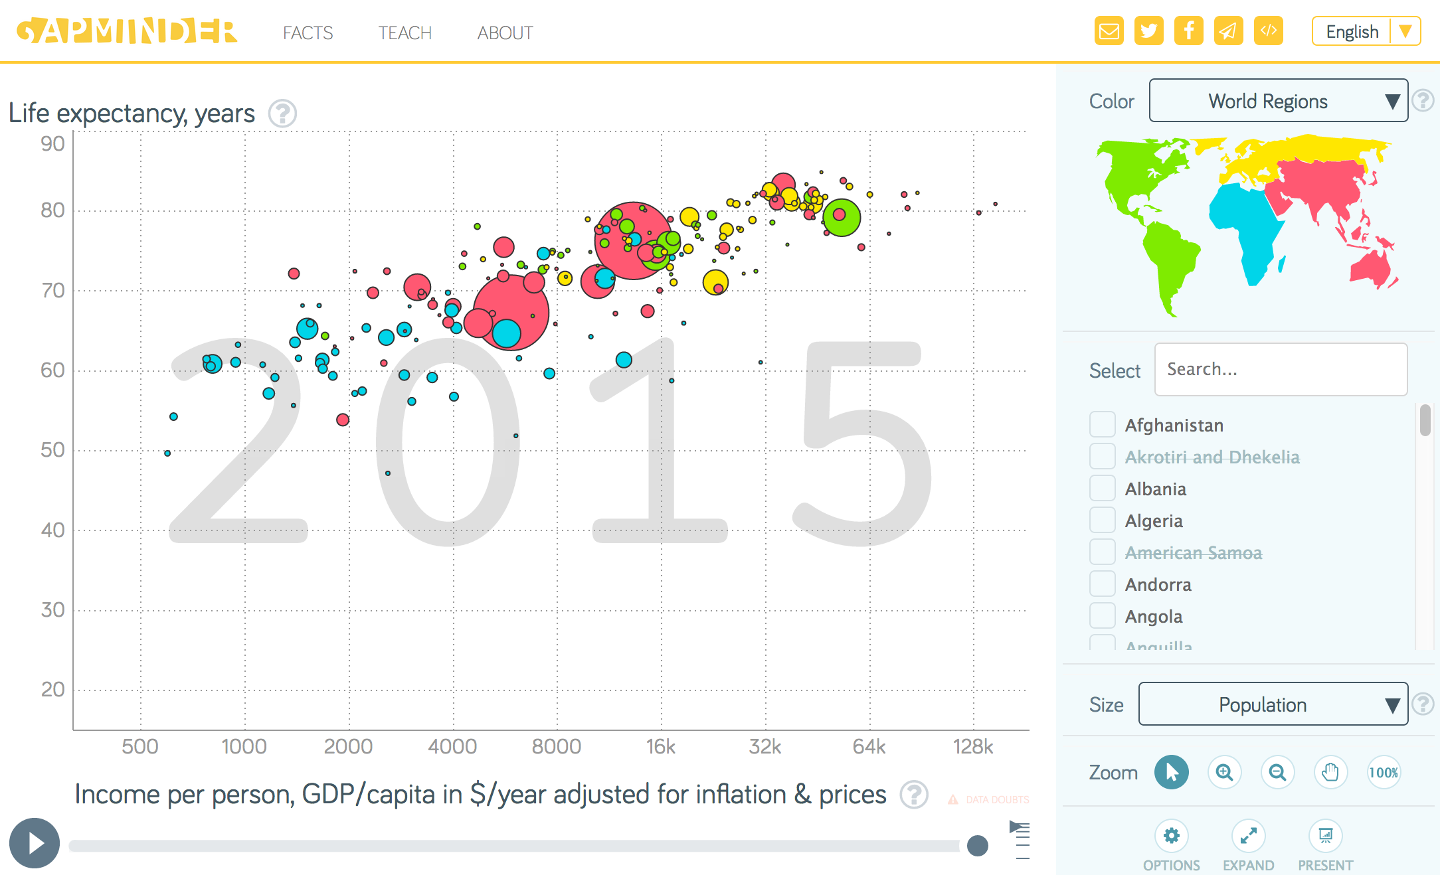
Gapminder.org
Notes:
Gapminder.org

Slide 62
IRE/NICAR data

Slide 64
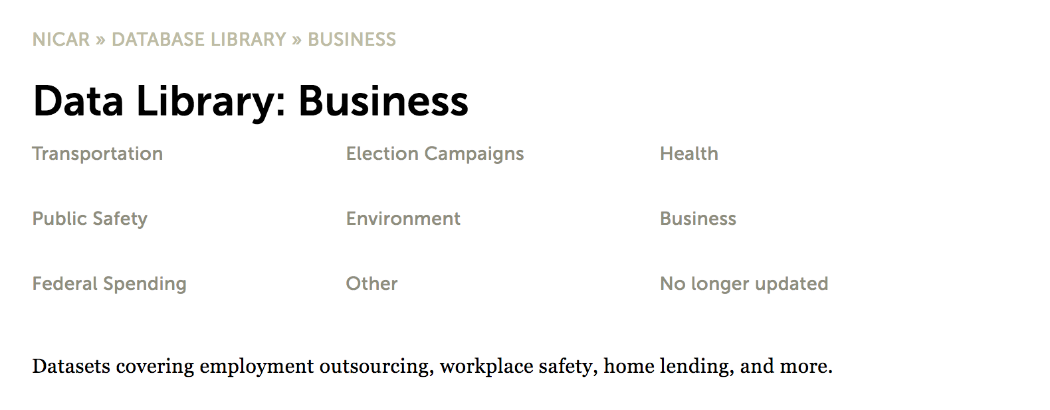
ire.org/nicar/database-library/category/business/

Slide 65
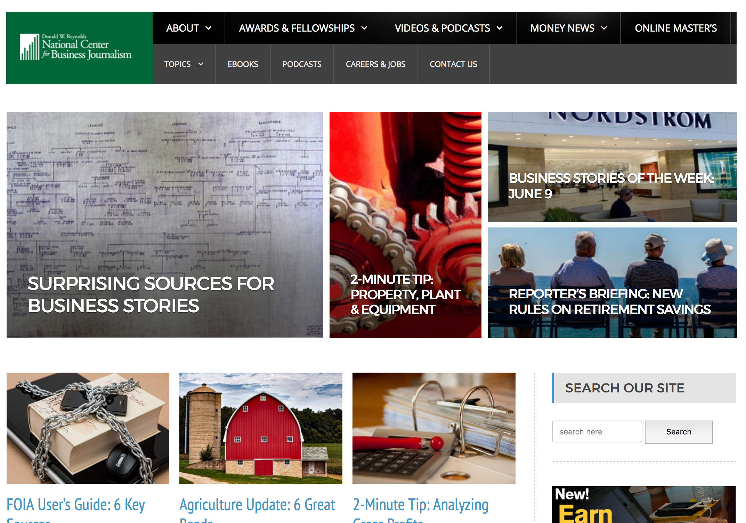
businessjournalism.org/

Slide 66
www.public.asu.edu/~sdoig/ire17/

